Slide 2
Understanding User Requirements

Slide 3
Approaches for gathering User Requirements
To gather user requirements, there are two approaches.
Product-centric approach
User-centric and usage-centric approach
Product-centric approach
Focuses on defining the features to implement in the software, with the hope that those features will appeal to prospective customers.
User-centric and usage-centric approach
Focusing on users and their anticipated usage helps reveal the necessary functionality, avoids implementing features that no one will use, and assists with prioritization.
Two techniques used are : Use Cases and User Stories
Difference:
what users need to accomplish
asking users what they want the system to do.

Slide 4
Applications of User-centered approach
Use cases and user stories work well for exploring the requirements for
business applications, websites, kiosks, and systems that let a user control a piece of hardware.
Use cases or user stories are inadequate for understanding the requirements of certain types of applications.
batch processes, computationally intensive systems, business analytics, and data warehousing, many embedded and other real-time systems.
The complexity of these applications lies in the computations performed, the data found and compiled, or the reports generated, not in the user-system interactions.

Slide 5
Use Case
A use case describes a sequence of interactions between a system and an external actor that results in the actor being able to achieve some outcome of value.
The names of use cases are always written in the form of a verb followed by an object.
Select strong, descriptive names to make it evident from the name that the use case will deliver something valuable for some user.

Slide 6
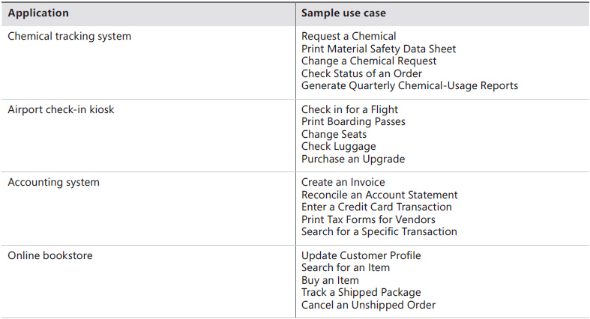
Examples of Use Cases

Slide 7
User Story
Used on agile development projects,
A “short, simple description of a feature told from the perspective of the person who desires the new capability, usually a user or customer of the system” (Cohn 2010).
User stories often are written according to the following template, although other styles also are used:
As a <type of user>, I want <some goal> so that <some reason>.

Slide 8
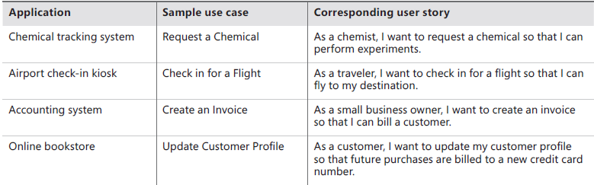

Slide 9
Similarities between a Use case and a User Story
Use case and user story both state the user’s goal
The user story also identifies the user class and the rationale behind the request for that system capability.
The user class—which need not be a human being—in a user story corresponds to the primary actor in a use case.
The rationale could be provided in the brief description of the use case.
Both use cases and user stories are focused on understanding what different types of users need to accomplish through interactions with a software system.
However, the two processes move in different directions from these similar starting points

Slide 10
Differences between Use Cases and User Stories

Slide 11
Use Cases lead to functional requirements
With use cases, the next step is for the BA to work with user representatives to understand how they imagine a dialog taking place with the system to perform the use case.
The BA structures the information collected according to a use case template.
From the use case specification,
the BA can derive the functional requirements that developers must implement, and
a tester can identify tests to judge whether the use case was properly implemented.
Developers might implement an entire use case in a single release or iteration or they might implement just a portion of a particular use case initially, either for size or priority reasons, and then implement additional parts in future releases.

Slide 12
User stories lead to acceptance tests
As employed on agile projects, a user story serves as a placeholder for future conversations that need to take place on a just-in-time basis among developers, customer representatives, and a business analyst
Those conversations reveal the additional information that developers must know to be able to implement the story.
Refining the user stories through conversations leads to a collection of smaller, focused stories that describe individual chunks of system functionality.
User stories that are too large to implement in one agile development iteration (called epics) are split into smaller stories that can be implemented within a single iteration

Slide 13
User stories lead to acceptance tests
Rather than specifying functional requirements, agile teams typically elaborate a refined user story into a set of acceptance tests that collectively describe the story’s “conditions of satisfaction.”
If the developer implements the necessary code to satisfy the acceptance tests—and hence to meet conditions of satisfaction—the user story is considered to be correctly implemented.

Slide 14
Which one is better – use case or user story?
User stories offer the advantage of simplicity and conciseness.
Use cases provide project participants with a structure and context that a collection of user stories lacks.
They provide an organized way for the BA to lead elicitation discussions beyond simply collecting a list of things that users need to achieve with the system as a starting point for planning and discussion.
A use-case analysis might reveal that several use cases involve similar exceptions (or other commonalities) that could perhaps be implemented as a single consistent error-handling strategy within the application. Such commonalities are more difficult to discern with a collection of user stories.

Slide 15
Use case approach
A use case describes a sequence of interactions between a system and an external actor that results in some outcome that provides value to the actor.
An actor is a person (or sometimes another software system or a hardware device) that interacts with the system to perform a use case.
For example, the Chemical Tracking System’s “Request a Chemical” use case involves an actor named Requester.
There is no CTS user class named Requester. Both chemists and members of the chemical stockroom staff may request chemicals, so members of either user class may perform the Requester role.
Users are actual people (or systems); actors are abstractions.

Slide 16
How to identify actors in Use cases
Following are some questions you might ask to help user representatives identify actors:
Who (or what) is notified when something occurs within the system?
Who (or what) provides information or services to the system?
Who (or what) helps the system respond to and complete a task?

Slide 17
Use case diagrams
Use case diagrams provide a high-level visual representation of the user requirements.
They are drawn using the Unified Modeling Language (UML) notation (Booch, Rumbaugh, and Jacobson 1999; Podeswa 2010).
The box frame represents the system boundary.
Arrows from each actor (stick figure) connect to the use cases (ovals) with which the actor interacts.
An arrow from an actor to a use case indicates that he is the primary actor for the use case.
The primary actor initiates the use case and derives the main value from it.
An arrow goes from a use case to a secondary actor, who participates somehow in the successful execution of the use case
. Other software systems often serve as secondary actors, contributing behind the scenes to the use case execution.
The Training Database is just such a secondary actor in Figure 8-2. This system gets involved when a Requester is requesting a hazardous chemical that requires the Requester to have been trained in how to safely handle such dangerous materials.

Slide 19
Difference between use case diagram and context diagram
Both define the scope boundary between objects that lie outside the system and things inside the system.
In the use case diagram, the box separates some internal aspects of the system—use cases—from the external actors.
The context diagram also depicts objects that lie outside the system, but it provides no visibility into the system internals.
The arrows in a context diagram indicate the flow of data, control signals across the system boundary.
In contrast, the arrows in a use case diagram simply indicate the connections between actors and use cases in which they participate; they do not represent a flow of any kind.

Slide 20
Use Case
A use case describes a discrete, standalone activity that an actor can perform to achieve some outcome of value.
A use case might encompass a number of related activities having a common goal.
A scenario is a description of a single instance of usage of the system.
A use case is therefore a collection of related usage scenarios, and a scenario is a specific instance of a use case.
When exploring user requirements, you can begin with a general use case statement and develop more specific usage scenarios, or you can generalize from a specific scenario example to the broader use case.

Slide 21
Example of Usecase

Slide 22
Essential elements of a use case
A unique identifier and a succinct name that states the user goal
A brief textual description that describes the purpose of the use case
A trigger condition that initiates execution of the use case
Zero or more preconditions that must be satisfied before the use case can begin
One or more postconditions that describe the state of the system after the use case is successfully completed
A numbered list of steps that shows the sequence of interactions between the actor and the system—a dialog—that leads from the preconditions to the postconditions

Slide 23
Preconditions and Postconditions
Preconditions define prerequisites that must be met before the system can begin executing the use case.
e.g. If the ATM is empty, it shouldn’t let a user even begin a withdrawal transaction.
Postconditions describe the state of the system after the use case executed successfully. Postconditions can describe:
Something observable to the user (the system displayed an account balance).
Physical outcomes (the ATM has dispensed money and printed a receipt).
Internal system state changes (the account has been debited by the amount of a cash withdrawal, plus any transaction fees).

Slide 24
Normal flows
One scenario is identified as the normal flow of events for the use case.
The normal flow is also called the main flow, basic flow, normal course, primary scenario, main success scenario, sunny-day scenario, and happy path.
E.g.
The normal flow for the “Request a Chemical” use case is to request a chemical that’s available in the chemical stockroom.
The normal flow is written as a numbered list of steps, indicating which entity—the system or a specific actor—performs each step.

Slide 25
Alternative Flows
Other success scenarios within the use case are called alternative flows or secondary scenarios.
Alternative flows deliver the same business outcome (sometimes with variations) as the normal flow but represent less common or lower-priority variations in the specifics of the task or how it is accomplished.
The normal flow can branch off into an alternative flow at some decision point in the dialog sequence; it might (or might not) rejoin the normal flow later.
The steps in the normal flow indicate where the user can branch into an alternative flow.
A user who says, “The default should be. . .” is describing the normal flow of the use case. A statement such as “The user should also be able to request a chemical from a vendor” suggests an alternative flow.

Slide 26
Alternative Flows in User Story
In the agile world, a user story sometimes covers the same scope as an entire use case, but in other cases a user story represents just a single scenario or alternative flow.
E.g.
As a chemist, I want to request a chemical so that I can perform experiments.
As a chemist, I want to request a chemical from the Chemical Stockroom so that I can use it immediately.
As a chemist, I want to request a chemical from a vendor because I don’t trust the purity of any of the samples available in the Chemical Stockroom.

Slide 27
Exceptions
Conditions that have the potential to prevent a use case from succeeding are called exceptions.
Exceptions describe anticipated error conditions that could occur during execution of the use case and how they are to be handled.
In some cases, the user can recover from an exception, perhaps by re-entering some data that was incorrect. In other situations, though, the use case must terminate without reaching its success conditions.
One exception for the “Request a Chemical” use case is “Chemical Is Not Commercially Available,” labeled as 4.1.E1 in the use case description.
If you don’t specify exception handling during requirements elicitation, there are two possible outcomes:
Each developer will make his best guess at how to deal with the exceptions he sees, leading to inconsistent error handling throughout the application and less robust software.
The system will fail when a user hits the error condition because no one thought about it.

Slide 28
Exceptions
You might defer some alternative flow to later iterations or releases.
However, you must implement the exceptions that can prevent the flows that you do implement from succeeding.
Overlooked exceptions are a common source of missing requirements.

Slide 29
Exceptions in User Story
Agile projects employing the user story approach address exceptions through the acceptance tests they create for each story.
E.g., “What if the chemical you want is not commercially available from any vendor?” This could lead to an acceptance test like, “If the chemical isn’t found in any available vendor catalogs, show a message to that effect.”

Slide 30
Activity Diagram
A UML activity diagram is a useful way to visually represent the logic flow in a complex use case, as illustrated in the following.
Activity diagrams show the decision points and conditions that cause a branch from the normal flow into an alternative flow.

Slide 31
Activity Diagram

Slide 32
Extend and include – Relationships between use cases
You can show two types of relationships, called extend and include, between use cases in a use case diagram.
The normal flow for the “Request a Chemical” use case is to request a chemical from the Chemical Stockroom; an alternative flow is to request a chemical from a vendor
The Buyer has a use case called “Search Vendor Catalogs.” Suppose you wanted to let the Requester execute that same “Search Vendor Catalog” use case as an option when requesting a chemical, as part of the alternative flow processing. A use case diagram can show that a standalone use case like “Search Vendor Catalogs” extends the normal flow into an alternative flow.

Slide 33
Extend use case

Slide 34
Include relationship
Sometimes several use cases share a common set of steps.
To avoid duplicating these steps in each such use case, you can define a separate use case that contains the shared functionality and indicate that the other use cases include that subordinate use case.
Consider an accounting software package. Two use cases are “Pay a Bill” and “Reconcile Credit Card,” both of which might involve the user writing a check to make the payment. You can create a separate use case called “Write a Check” that contains the common steps involved in writing the check

Slide 35
Include use case

Slide 36
Aligning preconditions and postconditions
In many applications, the user can chain together a sequence of use cases into a “macro” use case that describes a larger task.
Some use cases for an e-commerce website might be “Search Catalog,” “Add Item to Shopping Cart,” and “Pay for Items in Shopping Cart.”
If you could perform each of these activities independently, they are individual use cases.
However, you might also be able to perform all three activities in sequence as a single large use case called “Buy Product,” as shown in the following figure. The description of the “Buy Product” use case could simply say to perform each of those other three use cases in turn: “Search Catalog,” “Add Item to Shopping Cart,” and then “Pay for Items in Shopping Cart.”
The postconditions of one use case must satisfy the preconditions of the next one in the sequence.

Slide 37
Aligning preconditions and postconditions

Slide 38
Identifying use cases
Identify the actors first, then lay out the business processes being supported by the system, and define the use cases for activities where actors and systems interact.
Create a specific scenario to illustrate each business process, then generalize the scenarios into use cases and identify the actors involved in each one.
Using a business process description, ask, “What tasks must the system perform to complete this process or convert the inputs into outputs?” Those tasks might be use cases.
Identify the external events to which the system must respond, then relate these events to participating actors and specific use cases.
Use a CRUD analysis to identify data entities that require use cases to create, read, update, delete, or otherwise manipulate them
Examine the context diagram and ask, “What objectives do each of these external entities want to achieve with the help of the system?”

Slide 39
Use cases often involve some additional information or requirements that do not fit within any of the template sections. Use the “Other Information” section to record pertinent performance and other quality requirements, constraints, and external interface knowledge.

Slide 40
Use case Elicitation work products

Slide 41
Use cases and functional requirements
Software developers don’t implement business requirements or user requirements.
They implement functional requirements, specific bits of system behavior.
The user requirements don’t contain all the information that a developer needs to write the software.
E.g. The user of an ATM doesn’t know about any back-end processing involved, such as communicating with the bank’s computer.
To reduce this uncertainty, consider having a BA explicitly specify the functional requirements necessary to implement each use case.
You can document the functionality associated with a use case in several ways.

Slide 42
a. Use cases only
One possibility is to include the functional requirements along with each use case specification, if they aren’t already evident.
You’ll still need to document non-functional requirements and any functionality that’s not associated with a use case.
Additionally, several use cases might need the same functional requirement. Rather than duplicate them, cross-reference functional requirements that appear in multiple use cases.

Slide 43
b. Use cases and functional requirements
Another option is to write fairly simple use cases and document the functional requirements derived from each one in an SRS or a requirements repository. In this approach, you should establish traceability between the use cases and their associated functional requirements. That way, if a use case changes, you can quickly find the affected functional requirements. The best way to manage the traceability is with a requirements management tool.

Slide 44
c. Functional requirements only
One more option is to organize your functional requirements by use case or by feature, and include both the use cases and the functional requirements in the SRS or requirements repository.
Most of the use cases can be written in very concise form, not completing the full template. The details can then be specified through a set of functional requirements. This approach doesn’t result in a separate user requirements document.

Slide 45
d. Use cases and tests
If you write both detailed use case specifications and functional requirements, you might notice some duplication, particularly around the normal flow. There is little value in writing the same requirement twice. So another strategy is to write fairly complete use case specifications, but then write acceptance tests to determine if the system properly handles the basic behavior of the use case, alternative success paths, and the various things that could go wrong.

Slide 46
Use case traps to avoid
Too many use cases
Highly complex use cases
Including design in the use cases
Including data definitions in the use cases
Use cases that users don’t understand

Slide 47
.

